Slide 1
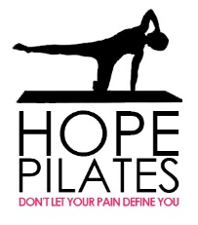
Truth about Flat Feet/Fallen Arches -
What are the best treatment options?

Slide 2
What is a “flat” foot?
This can mean several things.

Slide 3
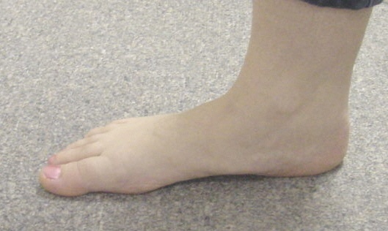
“Flat Foot” or “Fallen Arches”
Normal
Is a rather common problem affecting pediatric, adults, and geriatrics.
The foot is misaligned
There is displacement of the hindfoot bones forcing a lowering of the natural arch of the foot.
Not Normal

Slide 4
What kind of “flat feet” are there?
Not all misaligned feet are the same.

Slide 5
What are the choices?
Flexible flat foot
Semi-flexible flat foot
Rigid flat foot

Slide 6
“Flexible” Flat Foot
No Weight
There is an arch with no pressure on the foot.
Upon standing there is a loss of the height of the arch
The foot can be put back into its “normal” position during standing.
Weight

Slide 7
Semi-Flexible Flat Foot
There isn’t much of an arch with or without pressure on the foot.
The foot flattens out more during standing
Cannot be put fully back into its “normal” position.

Slide 8
Rigid Flat Foot
The foot has no arch on or off the ground.
Cannot be manually forced back into it’s normal position on or off the ground.

Slide 9
Flat Feet- Who Cares?
What difference does it make?

Slide 10
It makes a big difference to your quality of life.
The alignment and function of our feet plays a tremendous role in our ability to stand, walk, run, and exercise.
When are feet are in “alignment” they are functioning as they were designed. There is no excessive strain to the bones, ligaments, tendons, and muscles, as well as the neurovascular structures.

Slide 11
Poorly Aligned Feet
Sooner or later a “problem” will develop at the “weakest link of the chain” and is a sign that something is wrong.
With every step taken excessive abnormal forces are acting on the supporting structures of the foot.
Average person takes 6,000 to 10,000 steps a day.

Slide 12
“Functional Symptoms”
Due to the chronic nature of this disease process (walking is the 2nd most common conscious function of our body) the individual finally realizes that:
“The more active I am the worse my pain, the less active I am the pain isn’t so bad”

Slide 13
So then what happens?

Slide 14
We decrease our activity level.
If it hurts…don’t do it
We stay off of our feet and become lazy
We do whatever we can not to walk or stand because it simply gives us pain.
We suffer if we exercise so we don’t
Our metabolism decreases now the real problems begin……next slide please.

Slide 15
Decreased Metabolism
Body cannot burn off the calories
Increased weight gain
Obesity
Hypertension
Diabetes
Coronary Heart Disease
Syndrome X

Slide 16
Metabolic Syndrome X
Diabetes
Hypertension
Heart Disease
Obesity
Etc.
One of the first things your doctor tells you is to…
…EXERCISE.

Slide 17
“My feet are not properly positioned and they don’t bother me at all!”
Are you sure about that?

Slide 18
No Symptoms Yet?
Imagine our foot acting as the tire on our car.
We can place the tire on our car without balancing it.
It functions great, what’s the big deal about balancing the tire.
Who cares!

Slide 19
Oops…I guess it does matter
Sooner or later it will wear out.
Not only is the tire affected but it can adversely affect the other tires.
The steering also becomes misaligned.

Slide 20
It is only a matter of time
Average person takes : 7500 steps a day
50 years of age : 134,137,500 steps taken
This is not normal
Have you ever heard someone say:
“I just turned fifty and it seems like my body is just falling apart” I wonder why?

Slide 21
Misaligned Feet and the rest of your body.
The alignment of your feet significantly affects the rest of your body.

Slide 22
Our feet are the foundation of our body.
Normal hindfoot alignment

Slide 23
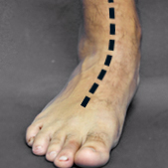
Misaligned feet leads to misalignment to the rest of our body.
Abnormal hindfoot Alignment

Slide 24
Could be a variety of factors
Hereditary
Idiopathic
Traumatic
Just born with it
Ligament Laxity
Etc.

Slide 25
Why does this happen?
A deeper explanation

Slide 26
Regardless what is happening?
The talus (ankle bone) is displaced from its normal position on the hindfoot or tarsal bones.
It falls off its normal alignment with the hind foot bones.
The talus turns inward and the foot turns outward.

Slide 27
Normal Alignment
This is what the hind foot alignment is supposed to look like.
Talus is sitting on top of the hind foot bones.
Sinus tarsi (natural spaced between the ankle & heel bone is in an “open” position.
Talus
Calcaneus

Slide 28
Abnormal Alignment
Talus is not sitting where it is supposed to be on the heel bone.
This partially collapses the sinus tarsi.
Partial talotarsal joint dislocation is present.
Excessively abnormal forces are acting on the foot.
Talus
Calcaneus

Slide 29
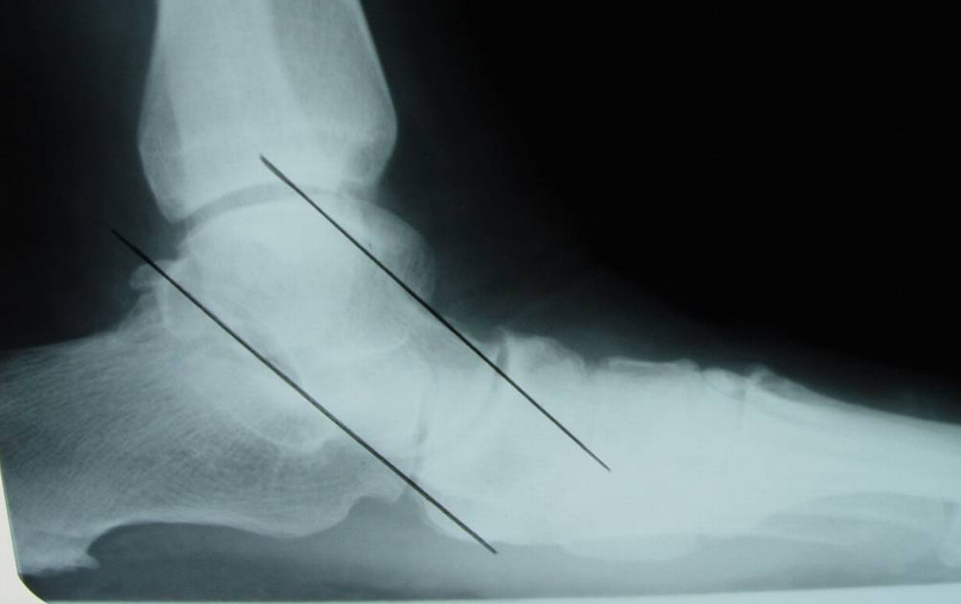
Not Normal.
Complete collapse of the sinus tarsi.
Talus is not where it is supposed to be.
This person is suffering one way or another because of misalignment of the ankle bone.

Slide 30
How are you going to fix my feet?
I get it, I don’t believe the people who tell me “just live with it”.

Slide 31
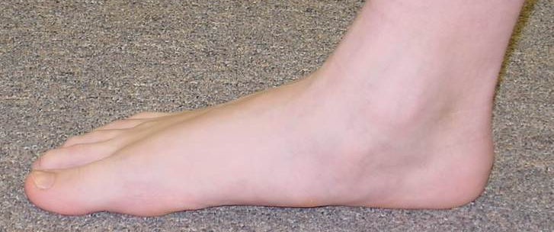
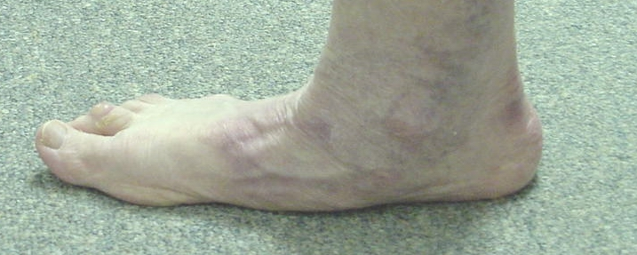
Treatment Options
It depends on what kind of “flat” foot you have.
Flexible
Semi-flexible
Rigid

Slide 32
Flexible Flat Foot Treatment
Let’s see which options make the most sense
Exercise- strengthen those muscles
“Special” Shoes- the foot can fix itself?
Arch Supports/Orthotics-
Extra-Osseous TaloTarsal Stabilization (EOTTS)
Reconstructive Hindfoot Surgery

Slide 33
Exercise- strengthen those muscles
Flexible Flat Foot Treatment
Specifically, Pilates Foot/Toe correction
The ligaments, tendons, & muscles are already working overtime.
They have to take an over-pronating foot bring it back to the normal position and then do their “regular” job to propel the foot.
It does make sense.

Slide 34
Flexible Flat Foot Treatment Options
“Special” Shoes- the foot can fix itself?
It is true that by elevating the heel this will help to reposition the ankle bone back on the heel.
What about when your not wearing shoes?
This does not really “fix” the problem.
There is still an internal deformity of excessive ankle bone motion.
Places increased pressure to the forefoot and can lead to other problems.

Slide 35
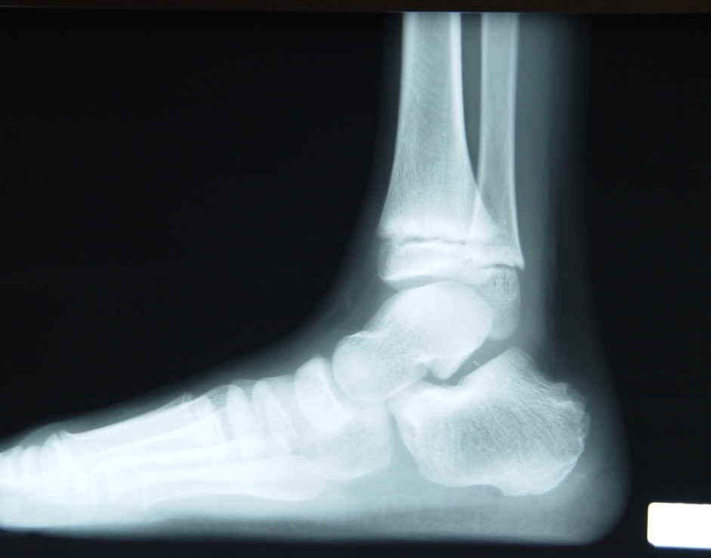
Arch Supports/Orthotics
Flexible Flat Foot Treatment Options
How can something on the bottom of the foot control something above?
The root of the deformity begins on top of the heel bone.

Slide 36
Problems with Arch Supports
At best they act like glasses.
Just because something “feels different” in your shoes doesn’t mean it is really fixing anything.
What about when you are not wearing shoes?
Maximum deformity is occurring with every step taken.
Limited with shoes you can wear.
Always have to buy new devices.
They can cause more harm than good.
Critical look at these offers a false sense of “correction”

Slide 37
With that said…
It is possible that an orthotic can provide some relief of symptoms but why not sort the foundation properly?
Pilates offers a non-surgical long term option by retraining the foot muscles
You would have to try it to believe it!

Slide 38
Pilates Foot & Toe corrector

Slide 39
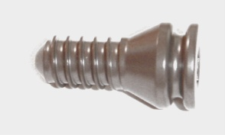
What happens if you do nothing?!
Extra-Osseous TaloTarsal Stabilization
(EOTTS)
The internal bone stabilization device supports the leading edge of the talus.

Slide 40
Extra-Osseous TaloTarsal Stabilization (EOTTS)
Risks
Benefits
Stent displacement
Period of abnormal walking, pain, swelling
Sprained ankle feeling
Inability of the tissues to stretch out due to the corrected alignment
Need for stent removal
Other risks associated with surgery.
Internal correction
Effectively stabilizes the hindfoot
Not dependent on external factors-shoes, braces, etc.
Should be a “permanent” fix but can always be resized or removed if needed.

Slide 41
Refuse to just live with your misaligned feet.
There are real solutions out there for you.

Slide 42
Feedback we want to hear from you.
info@hopepilates.com

